Slide 1
JAVA
Unit 7

Slide 2
Multithreading
Multithreading in java is a process of executing multiple threads simultaneously.
A thread is a lightweight sub-process, the smallest unit of processing. Multiprocessing and multithreading, both are used to achieve multitasking.
However, we use multithreading than multiprocessing because threads use a shared memory area. They don't allocate separate memory area so saves memory, and context-switching between the threads takes less time than process. Also, Threads are independent. If there occurs exception in one thread, it doesn't affect other threads.

Slide 3
Multithreading
The Java language is, at its core, a threaded language. Every Java application runs at least two threads: the main thread started by the function:
public static void main( String args[] );
and a garbage collection thread which deallocates unused pointer memory as needed.

Slide 4
Advantages of Multithreading
It doesn't block the user because threads are independent and you can perform multiple operations at the same time.
You can perform many operations together, so it saves time.
Threads are independent, so it doesn't affect other threads if an exception occurs in a single thread.

Slide 5
Limitation of Multithreading
In the case of multithreading we cant predict the exact order of output because it will vary from system to system or JVM to JVM.

Slide 6
Creating threads
There are two ways to create a thread:
1. By extending Thread class: Thread class provide constructors and methods to create and perform operations on a thread. Thread class extends Object class and implements Runnable interface.
2. By implementing Runnable interface: The Runnable interface should be implemented by any class whose instances are intended to be executed by a thread. Runnable interface have only one method named run().
Public void run(): is used to perform action for a thread.

Slide 7
Starting a thread
start() method of Thread class is used to start a newly created thread. It performs following tasks:
A new thread starts.
The thread moves from New state to the Runnable state.
When the thread gets a chance to execute, its target run() method will run.

Slide 8
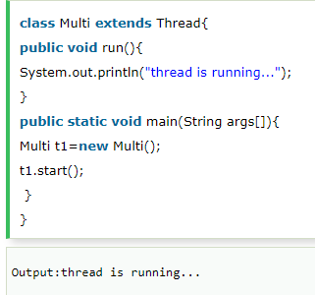
Java Thread Example by extending Thread class

Slide 9
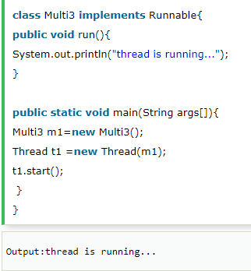
Java Thread Example by implementing Runnable interface

Slide 10
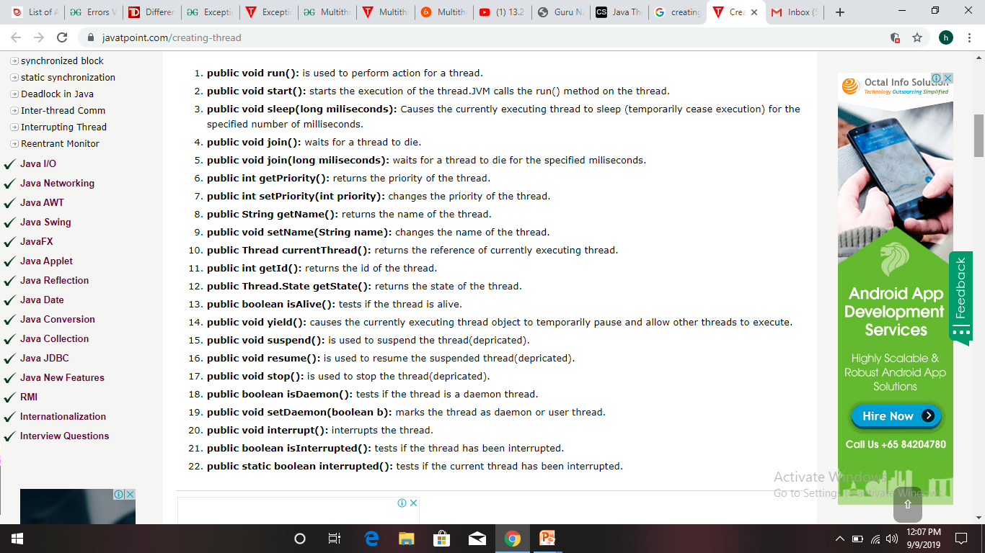
Commonly used methods of Thread class

Slide 11
Multithreading Example
https://www.youtube.com/watch?v=Xj1uYKa8rIw: Best explanation

Slide 12
Life cycle of a Thread
There are 5 states of thread
New
Runnable
Running
Non-Runnable (Blocked)
Terminated

Slide 13
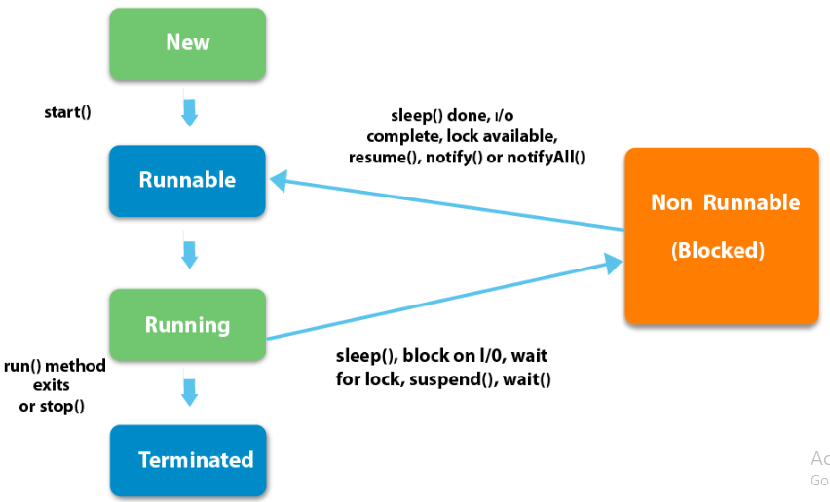
Life cycle of a Thread

Slide 14
Life cycle of a Thread
1. New: The thread is in new state if you create an instance of Thread class but before the invocation of start() method.
2) Runnable: The thread is in runnable state after invocation of start() method, but the thread scheduler has not selected it to be the running thread.
3) Running: The thread is in running state if the thread scheduler has selected it.
4) Non-Runnable (Blocked): This is the state when the thread is still alive, but is currently not eligible to run.
5) Terminated: A thread is in terminated or dead state when its run() method exits.

Slide 15
Main thread
When a Java program starts up, one thread begins running immediately. This is usually called the main thread of our program, because it is the one that is executed when our program begins.
Properties :
It is the thread from which other “child” threads will be spawned.
Often, it must be the last thread to finish execution because it performs various shutdown actions

Slide 16
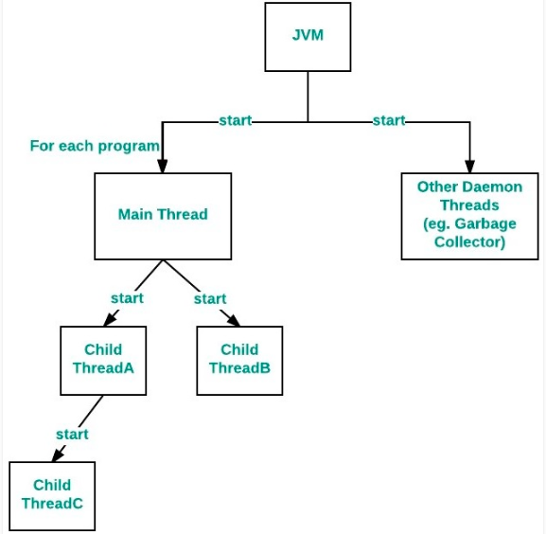
Main thread

Slide 17

Main thread
public class Test extends Thread
{
public static void main(String[] args)
{
// getting reference to Main thread
Thread t = Thread.currentThread();
// getting name of Main thread
System.out.println("Current thread: " + t.getName());
// changing the name of Main thread
t.setName("Geeks");
System.out.println("After name change: " + t.getName());
// getting priority of Main thread
System.out.println("Main thread priority: "+ t.getPriority());
}

